Slide 1
Healthcare Analytic

Slide 2
Problem Statement
In order to enhance the quality of healthcare services and improve patient satisfaction, there is a need to analyze the provided dataset, which includes information on patient visits, satisfaction scores, wait times, department referrals, and demographic details. The analysis aims to determine the total number of patients visits per year, understand the distribution of patients across different departments based on referrals, and identify the most visited departments. The insights gained from this analysis will contribute to informed decision-making, enabling the healthcare facility to optimize resources, reduce wait times, and enhance patient experiences.

Slide 3
Data
Date: Date and time of patient record creation
Patient id: Unique identifier for each patient
Patient gender: Gender of the patient (M for Male, F for Female)
Patient age: Age of the patient
Patient sat score: Patient satisfaction score (if available)
Patient name: name of the patient
Patient race: Race or ethnic background of the patient
Patient admin flag: Flag indicating whether the patient is an admin (TRUE or FALSE)
Patient wait time: Waiting time before being seen by a healthcare professional
Department referral: Department to which the patient was referred (if applicable)

Slide 4
Methodology
Data Integration: Leverage Power BI for healthcare dashboard creation by integrating diverse data sources through effective data modeling and transformation.
Dashboard Design: Create a visually compelling Power BI healthcare dashboard by strategically selecting key metrics, utilizing appropriate visualizations, and ensuring an intuitive layout for effective data communication.
Interactivity: Enhance Power BI healthcare dashboards with interactivity by implementing filters, slicers, drill-down features, and dynamic content for a user-driven exploration of healthcare data

Slide 5
Outcomes
Evaluate the average waiting time of patient.
Patients visit on weekly, monthly and yearly basis.
Total visit by department referral.
Breakdown patients visit by age group.
Determine the average Satisfaction by age-group and Patient race.
Determine the average Wait Time by age-group and Patient race.

Slide 6
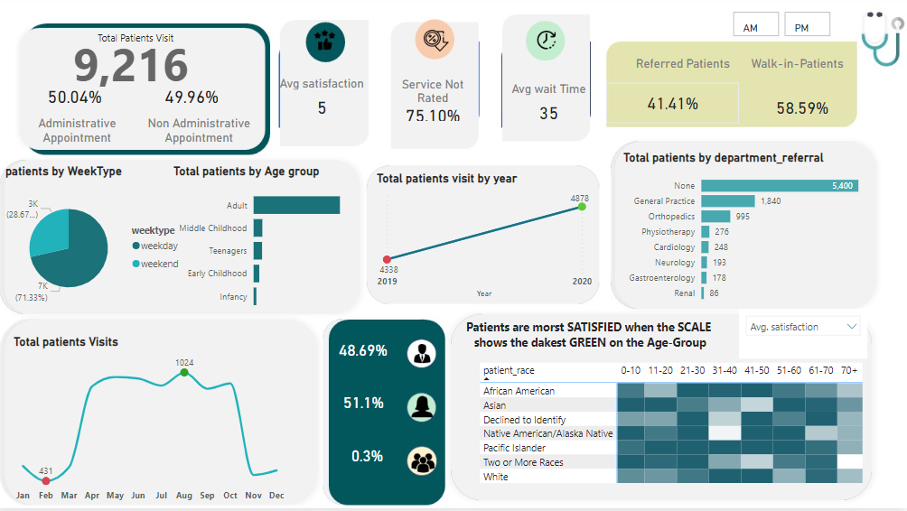

Slide 7
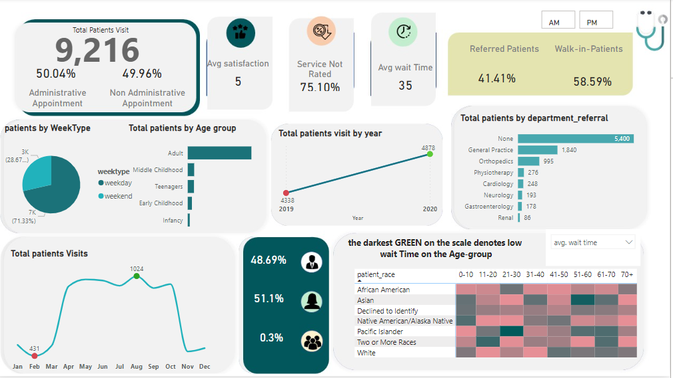

Slide 8
Thank You

